Slide 1

Exemplars, Laggards, and Hoarders
A Data-Driven Look at Open Source Software Supply Chains
Derek E. Weeks
VP and DevOps Advocate, Sonatype
Co-founder, All Day DevOps
@weekstweets

Slide 2
…once it ceases to
sacrifice quality for speed
CREDIT: NEIL BEYERSDORF
Notes:
An organization’s journey to excellence begins once it ceases to sacrifice quality for speed.” - Neil Beyersdorf Infographic published by Neil Beyersdorf linkedin.com/in/neilbeyersdorf

Slide 3

2018: Nicole Forsgren
Notes:
FASTER IS BETTER
46 times more frequent code deployments
more profitable and have higher market share.
They have 7 times lower change failure rates
They are 2,604x faster time In their times to recover
High performing DevOps teams are 1.75x more
likely to extensively use open source software
====
* Nicole Forsgren PhD, Jez Humble, Gene Kim. Accelerate: The Science of Lean Software and DevOps: Building and Scaling High Performing Technology Organizations. IT Revolution Press, March, 2018.

Slide 4
2013: Gene Kim
Notes:
It was this extensive use of open source in high performing DevOps teams
that led to an intersection of research that I had been leading for five years in the SSC report,
And research that Dr. Steven Magill, Gene Kim, Bruce Mayhew, Gazi Mahmud, and I embarked upon a year ago
You see, Gene Kim shared the Three Ways of DevOps inside The Phoenix Project,
with the first way being
“Emphasize performance of the entire system and never pass a defect downstream.”

Slide 5
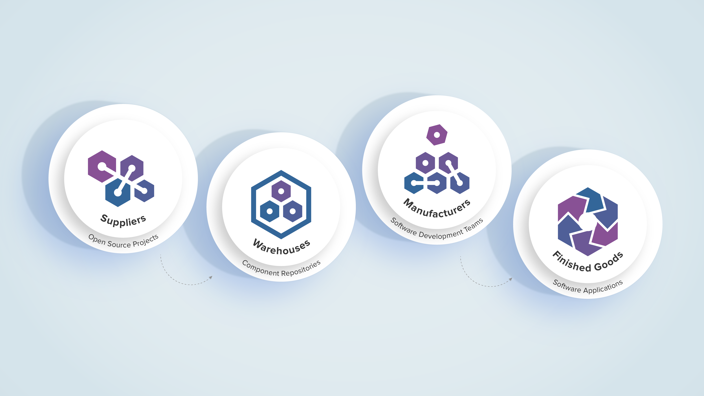
Everyone has a software supply chain.
(including open source projects)
Notes:
36,000
components
3.7 million
Releases
12,000
organizations
6,200
developers
86,000
applications

Slide 6
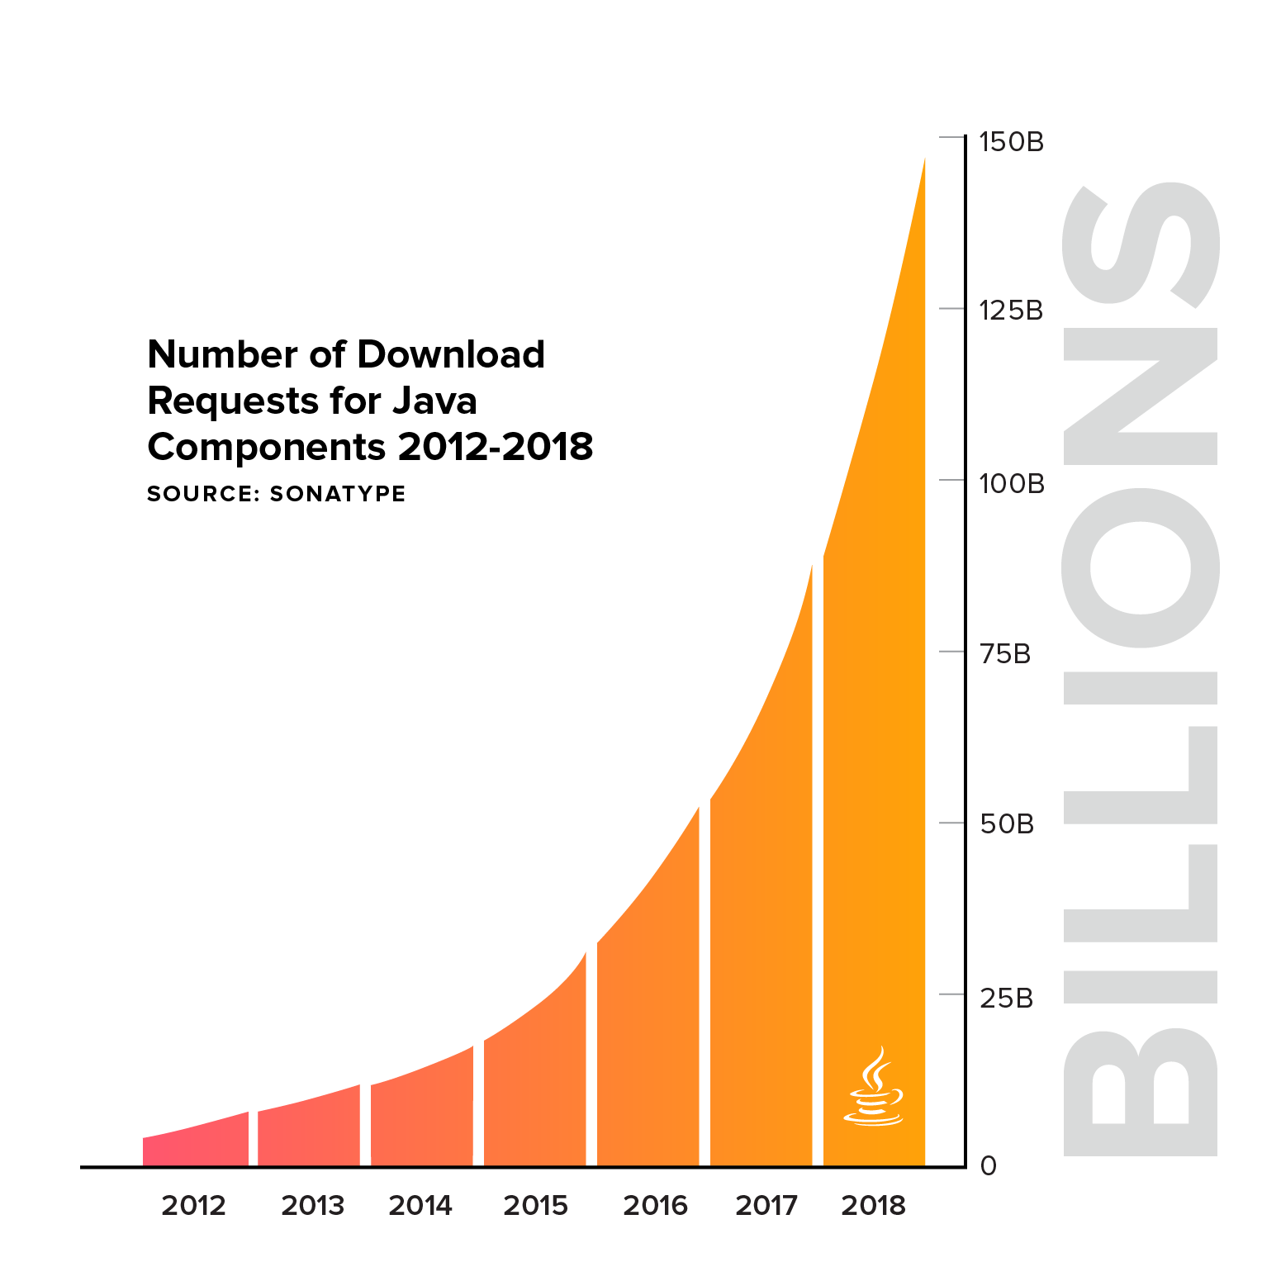
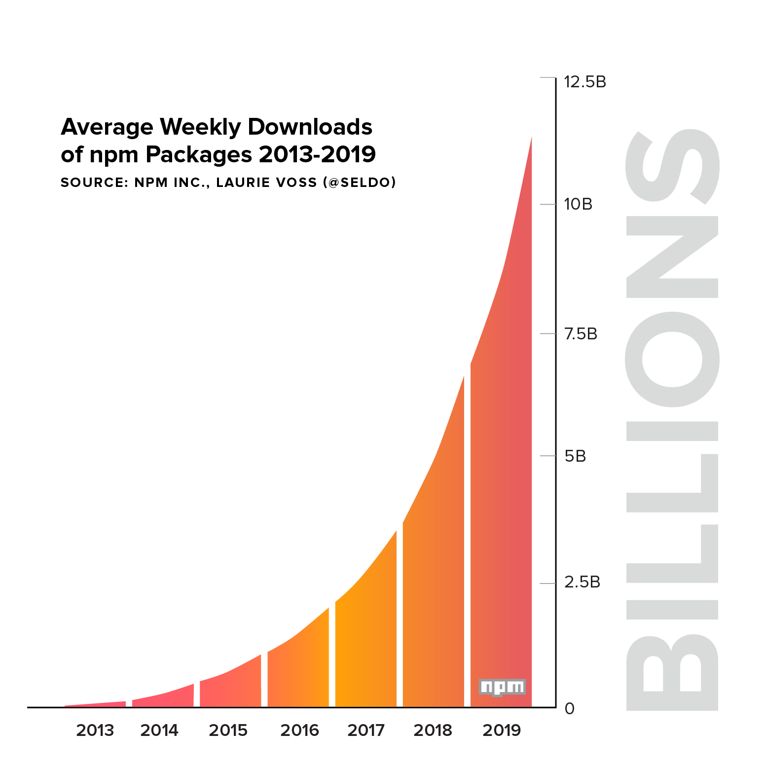
OSS download volumes are a proxy for build automation.
@weekstweets
Notes:
146 billion download requests for Java
11 billion package downloads for JavaScript
On average, developers had access to more than 21,448 new open source component releases every day, since the beginning of 2018.

Slide 7
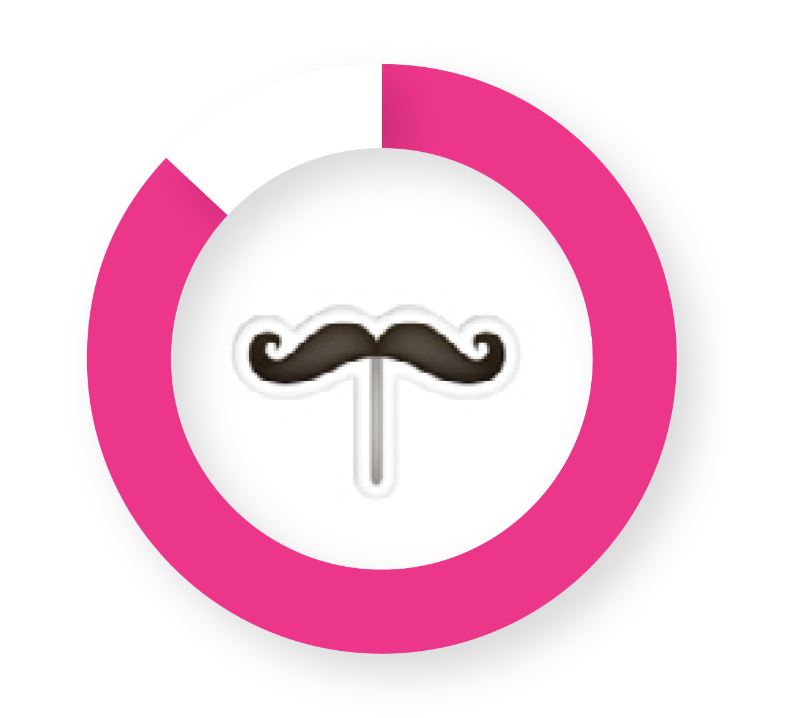
85%
of your code is sourced from external suppliers
@weekstweets

Slide 8

313,000
java component downloads annually
2,778
Component suppliers
8,200
Component release
27,704
8.8% with known vulnerabilities
@weekstweets

Slide 9
…faster is better
in the enterprise

Slide 10
…faster is better
for open source?
Notes:
An organization’s journey to excellence begins once it ceases to sacrifice quality for speed.” - Neil Beyersdorf Infographic published by Neil Beyersdorf linkedin.com/in/neilbeyersdorf

Slide 11
How do you pick the best suppliers?
Notes:
You have over 2700 suppliers of external code.
How do you pick the best suppliers for your code? How does Toyota pick the best suppliers for its code?

Slide 12
Two Different Worlds
Enterprise | Open Source
Multiple deploys per day | Versioned releases
Consistent development team | Fluid group of developers
Predictable, well-resourced | Variable resource availability
@weekstweets
Notes:
since we are here at the devops Enterprise Summit I want to start with the core devops mantra “faster is better”
so is there a convention we've heard a lot about both anecdotally and then in some great research by Nicole Forsgren, Jez humble and a gene Kim support for this concept that
“improved deployment time and frequent deployments leads to a number of positive outcomes including in the dimensions of profitability, market share, quality and so forth.
We’re all familiar with that from the Enterprise side, but one question that we wanted to ask is “does this trend hold an open source software?”
and there's no reason necessarily to think that it would. these are two very different worlds.
the Enterprise and open source so on the Enterprise side we can achieve multiple deploys per day on the open-source side
For Better or Worse we're stuck in this world of versions releases on using things like semantic versioning
on the Enterprise side we have consistent development teams where within open-source that's more and more fluid group of developers
on the Enterprise side we have well resource development or if your snickering at that at least predictably resource development teams on the open-source side as much less predictable much less variable

Slide 13
With Similar Metrics
Enterprise | Open Source
Deployment Frequency | Release Frequency
Organizational Performance | Popularity
Mean Time to Restore | Time to Remediate Vulnerabilities
@weekstweets

Slide 14
With Similar Metrics
Enterprise | Open Source
Deployment Frequency | Release Frequency
Organizational Performance | Popularity
Mean Time to Restore | Time to Remediate Vulnerabilities
@weekstweets

Slide 15

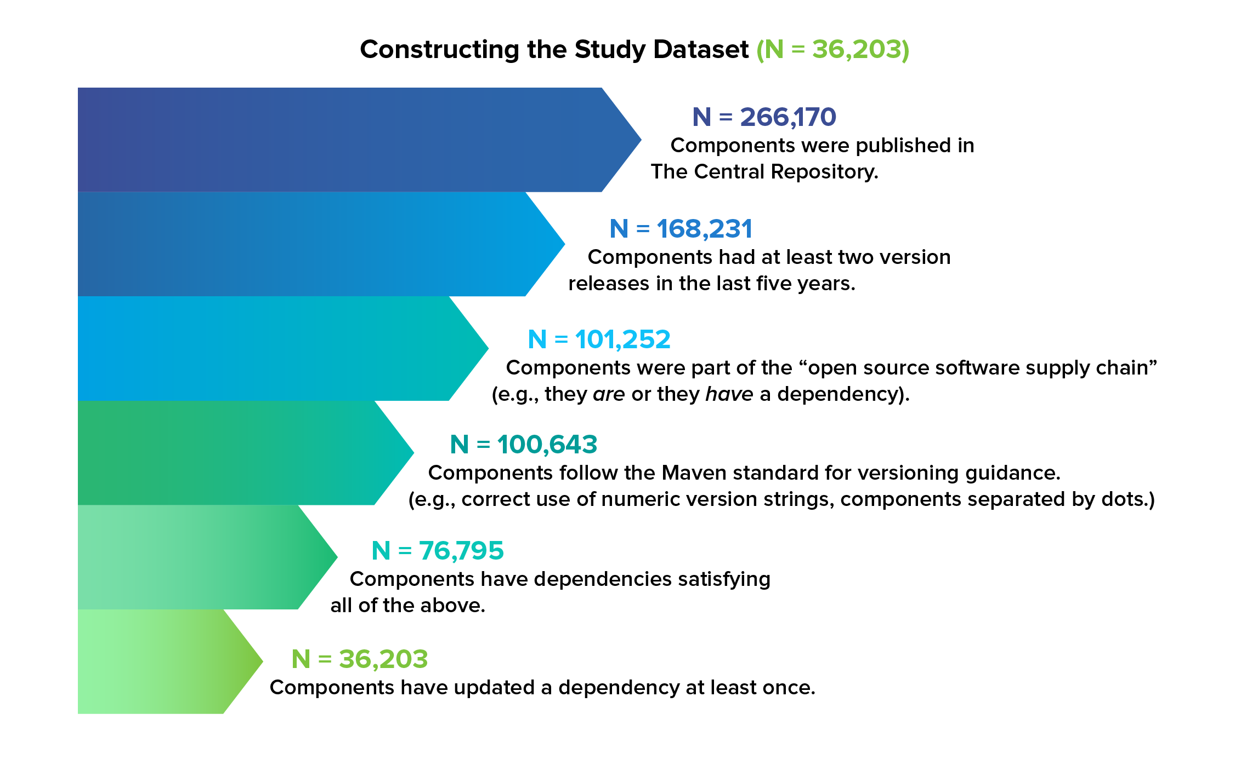
@weekstweets
Notes:
I want to talk a little bit about the dataset so first of all we focused on Java projects publish to Maven Central there about 260,000 of those and then we apply the number of filters to get down to a course out of components that we that we felt we could analyze well
so those filters were first of all we looked in the last 5 years I can develop development Trends culture tools and Technology of changed over time we wanted to find things that hold today and in the last five years we also throughout components that we didn't have enough data about to really draw conclusions so for example we wanted to measure release frequency the average time between new releases the component is only put one release out there there's never been a follow-up release we can't even met her by chance they don't use any open source libraries and they're not used by any other projects so there's sort of isolated off of it all by themselves so when we apply all of these we get down to a course out of 36000 components and our research and for those components

Slide 16
Attributes | Measure
Popularity | Avg. daily Central Repository downloads
Size of Team | Avg. unique monthly contributors
Development Speed | Avg. commits per month
Release Speed | Avg. period between releases
Presence of CI | Presence of popular cloud CI systems
Foundation Support | Associated with an open source foundation
Security | More complicated
Update Speed | More complicated
@weekstweets
Notes:
we looked at a number of different attributes things like popularity the size of the development team development Speed release speed and so forth from any of these we have data across those entire 36,000
so for example popularity we Define as the average daily Maven Central downloads and we have that data for every component of other things like size of development team we get that from GitHub data associated with the project so we only have that for the projects that are on guitar and they're about ten thousand of those
I answer most of these attributes are self-explanatory
there's a couple of the bottom though that warrant a little bit more discussion so security and update speed a little bit more complicated because of the complexity of Open Source Supply chains

Slide 17
Hypothesis 1
Projects that release frequently have better outcomes. ︎
@weekstweets

Slide 18
Hypothesis 1
Projects that release frequently have better outcomes. ︎
(VALIDATED)
@weekstweets
Notes:
so now we can look at a couple of these attributes and say you know does this faster is better relationship hold an open source and look at release frequency vs. popularity
and this is one of the hypotheses that we enter this project with let's see if we can find data to validate this hypothesis that projects that release frequently have better outcomes and in fact we find support for this so if you look at the top 20% by release frequency that group is 5 times more popular than the rest of the population attracts on average 79% more developers to contribute to the project and has 12% of Greater rates of foundation support
should view these as a descriptive statistics about the population, where we could see the correlation and not the causation

Slide 19
Projects that release frequently:
are 5x more popular.
attract 79% more developers.
have 12% greater foundation support rates.
@weekstweets

Slide 20
With Similar Metrics
Enterprise | Open Source
Deployment Frequency | Release Frequency
Organizational Performance | Popularity
Mean Time to Restore | Time to Remediate Vulnerabilities
@weekstweets

Slide 21

1945: W. Edwards Deming
Notes:
Let’s go back to 1945
when W. Edwards Deming started advising Japanese manufacturers to
detect and fix defects at the beginning of the manufacturing process.
He advised them to:
Source materials from the best suppliers
Source only the best parts from those top suppliers
Companies like Mitsubishi and Toyota Motor Co. applied Deming’s TQM practices are rose to global dominance
In 1981, Ford adopted these principles and within 6 years became the most profitable US auto manufacturer
Now tied into high-performance production processes, six-sigma manufacturing today aims a defect rate goal of 3.4 parts per million.
Today, software is at 1 in 10
How can we pick the best suppliers?
----
Among the key disciplines he preached:
Source materials from the best suppliers
Source only the best parts from those top suppliers
Trace and track the location of parts from start to finish, throughout the supply chain manufacturing process
Provide a Bill of Materials after a vehicle is released to conduct an orderly recall in the event of a faulty part
“Cease dependence on mass inspection.”
Emphasize performance of the entire system and never pass a defect downstream
Inspection does not improve quality. Nor guarantee quality. Inspection is too late.
Harold F. Dodge: “You cannot inspect quality into a product”
Automatic inspection and recording require constant vigil.

Slide 22
The Key Metrics:
Time to Remediate
Time to Update
Stale Dependencies
@weekstweets

Slide 23
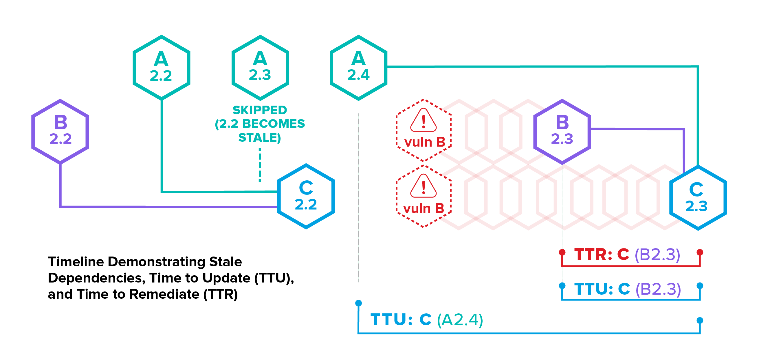
Security: Time to Remediate (TTR)
@weekstweets
Notes:
What were we looking to measure across these 36,000 projects?
Here is a visualization of three components A, B, &C and the dependency relationship between them
time is marching along from left to right
======
how those are Define so here we have an example of so the weight of you this chart is
so version 2.2 of B comes out then version 2.2 of a wave inversion 2.3 l A and so on
left or right the lines show dependency relationships.
so for example version 2.2 of C depends on version 2.2 of B and then we also have a vulnerability disclosure represented here
so there's a point in time at which there's a vulnerability reported against component B there's a and then B releases version 2.3 to mitigate that there's a. Of time where B is vulnerable and because C includes be as a dependency there's a. Of time where C is vulnerable and so we can measure each of these times
but if you think about it from Cedar Point of View the important time frame to think about is how long it takes him to respond to the release of the past version of B is really the first opportunity C has to know mitigate this Downstream security risks that use imported via his software supply chain security relevant metric that we measure and we call that time to remediate TTR
we also just measure update time in general and so that's a new release of these or see is you know take some time to incorporate that new releases be that's the update time for B is not a time for A as well even though there's no security vulnerability against that
every new release or some Associated time to update
we looked at is this notion of stale dependency so we often see a project release and maybe some of its dependencies wheel will be updated to the latest version but others others will be behind
you see that happening here with C where a version 2.3 has been released at the point where C version 2.2 comes out but C is not using that they're not using latest version of its time to update and steel dependency switch or just general update hygiene mix and

Slide 24
Security: Time to Remediate (TTR)
B Vulnerable Time
@weekstweets
Notes:
In this visualization, we wanted to understand and measure
A vuln is found in B 2.2
B 2.3 updates it

Slide 25
Security: Time to Remediate (TTR)
C Vulnerable Time
@weekstweets

Slide 26
Security: Time to Remediate (TTR)
C Remediation Time
@weekstweets

Slide 27
Security: Time to Update (TTU)
C Update Time (for B)
@weekstweets

Slide 28
Security: Time to Update (TTU)
C Update Time (for A)
@weekstweets
Notes:
We also wanted to understand how fast C would update all dependencies, including A

Slide 29
Security: Stale Dependencies
Stale Dependency
@weekstweets

Slide 30
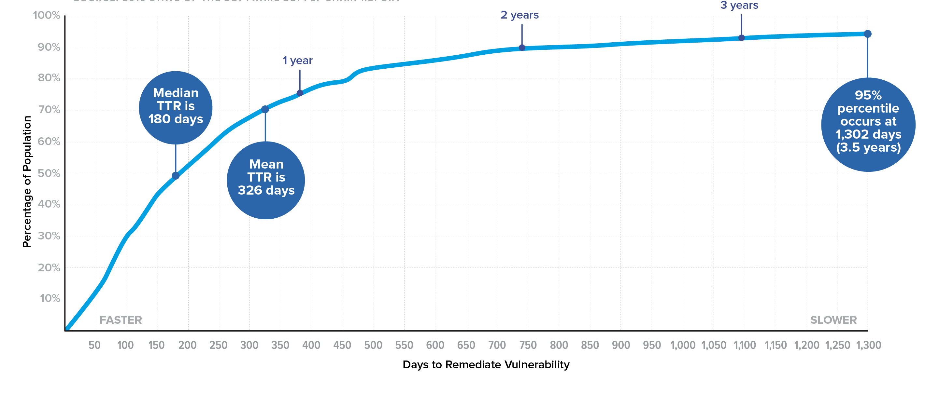
Time to Remediate Vulnerabilities
Notes:
I want to focus on the security relevant part for just a bit because of what Derek was saying about the the prevalence of vulnerabilities in the supply chain and how that trickles down into two users of those open source projects
so if we look at the time it takes these projects to apply security relevant patches the median time is about six months which is already not great and it gets even worse if you look sort of it the right of the speaker at the 95th percentile we see that 5% of projects take three and a half years or more
Ago by a security relevant patch and these are not projects that just like never like they did eventually apply it just took them three and a half years to get there

Slide 31
Time to Remediate Vulnerabilities
Do these update quickly in general?
Notes:
Do these projects stay up to date in general? (The projects with strong MTTR)
They are many more updates to perform in general, than vulnerabilities to correct.

Slide 32
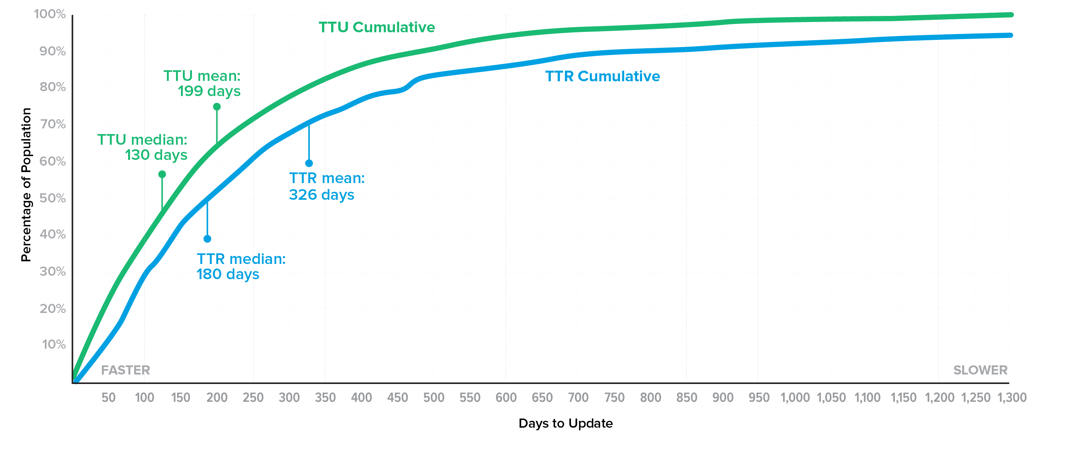
Time to Remediate (TRR) vs. Time to Update (TTU)
Most projects stay secure by staying up to date.
@weekstweets
Notes:
Most projects stay secure by staying up-to-date.
55% have MTTR and MTTU within 20% of each other.
Only 15% maintain better than average MTTR with worse than average MTTU.

Slide 33
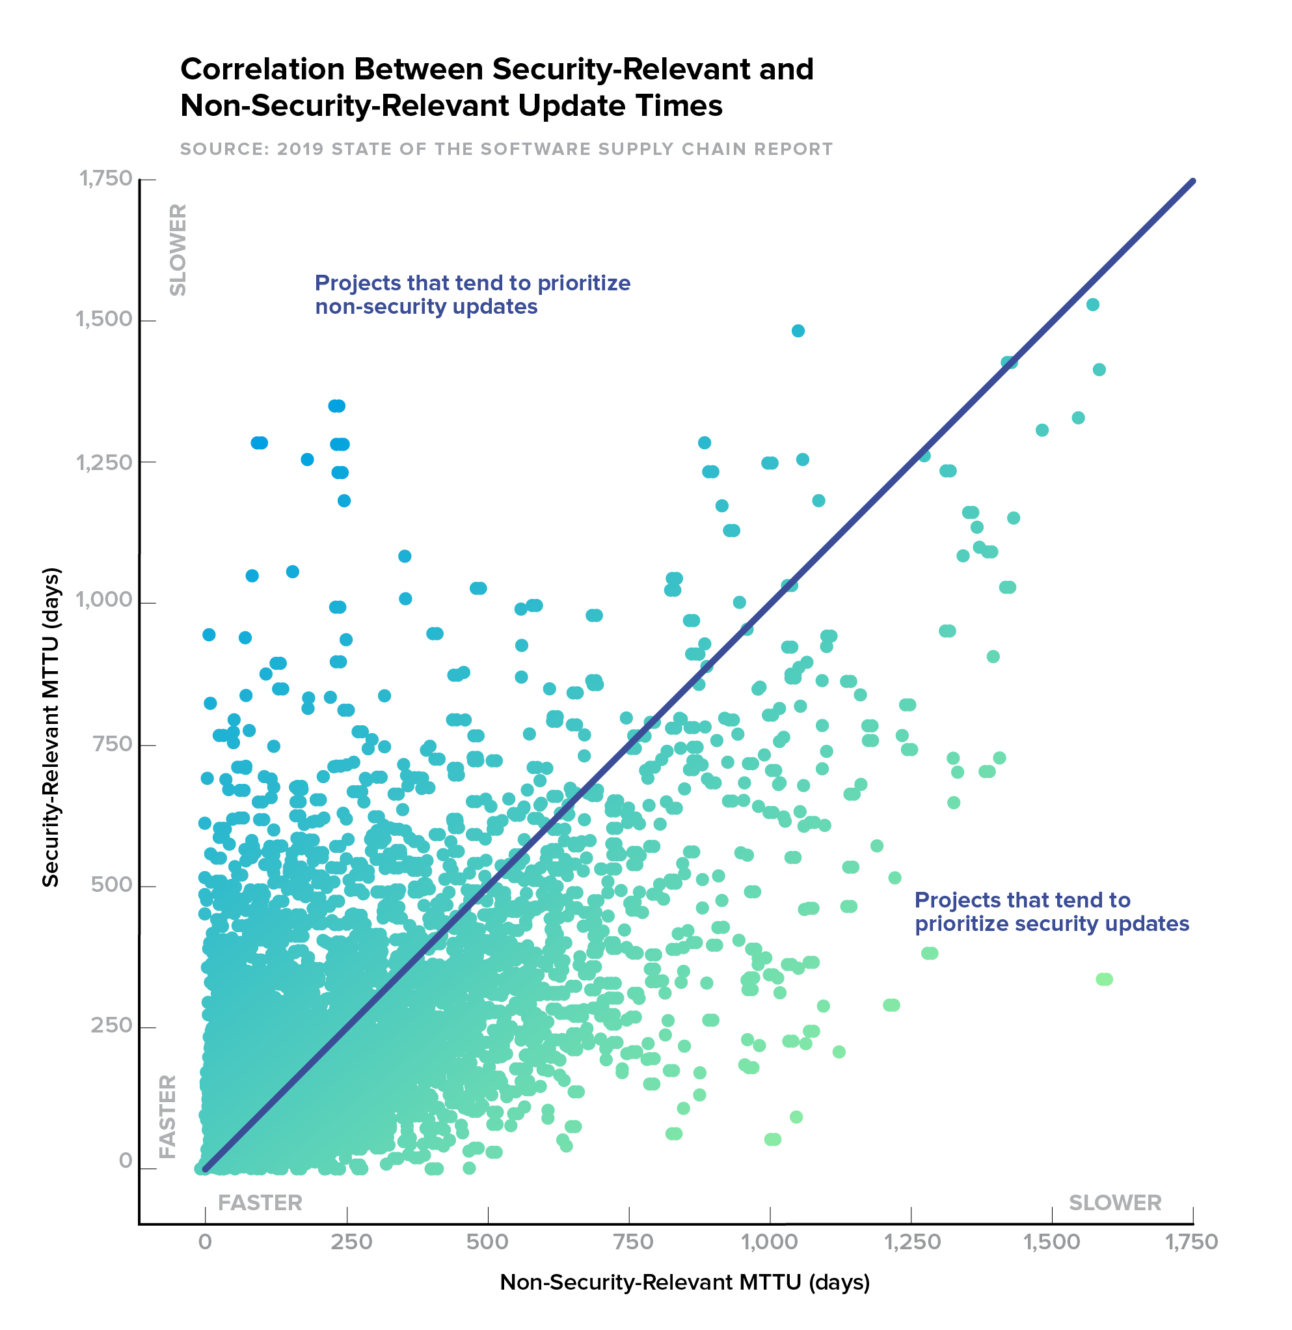
Time to Remediate (TTR) vs. Time to Update (TTU)
What are the characteristics of the best projects?
@weekstweets
Pearson correlation 0.6
Notes:
actually we do see a correlation between update behavior in general and update behavior for security relevant updates of how quickly projects applying for developing updates versus how quickly we apply security Roman updates and we see we see a reasonable correlation here there's a point six correlation coefficient between two and you certainly see projects that fall on one side or the other in a bit better about security or for whatever reason that end up performing better on on security
but if you if you dig into the date a little bit more we see that 55% of project have an empty tea are in an empty Tu that are within 20% of each other so they're sort of close to this line and and if you look for projects that manage to stay up-to-date from a security perspective while not updating at dependencies in general so they they do very good and remediating vulnerabilities but don't keep the rest of their dependencies up to date
so small population only 15% of projects end up having that exhibiting odd behavior so stay secure by staying up to date as a common behavior is just stay up-to-date in general and as a consequence so that was a second hypothesis that we entered into this research with and

Slide 34
Hypothesis 2
Projects that update dependencies more frequently
are generally more secure.
@weekstweets

Slide 35
Hypothesis 2
Projects that update dependencies more frequently
are generally more secure.
(VALIDATED)
@weekstweets

Slide 36
Most projects stay secure by staying up to date.
55% have MTTR and MTTU within 20% of each other.
Only 15% maintain better than average MTTR.
@weekstweets
Notes:
Only 15% maintain better than average MTTR with worse than average MTTU.

Slide 37
Hypothesis 3
Projects with fewer dependencies will stay more up to date.
@weekstweets

Slide 38
Hypothesis 3
Projects with fewer dependencies will stay more up to date.
(REJECTED)
Components with more dependencies actually have better MTTU.
@weekstweets

Slide 39
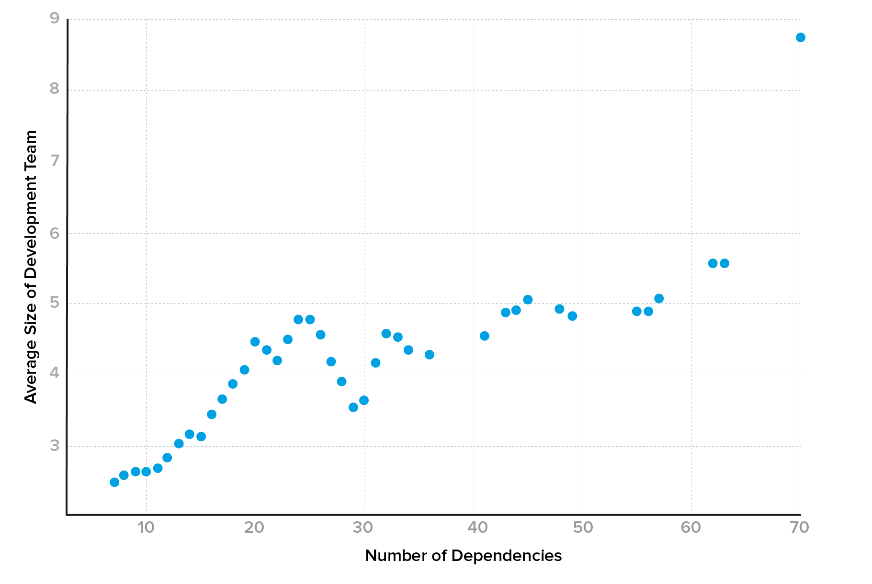
More dependencies correlate with larger development teams.
Larger development teams have 50% faster MTTU and release 2.6x more frequently.
@weekstweets
Notes:
we found some data to validate that another hypothesis that we came in with was that projects with fewer dependencies will stay up-to-date better and intuitively this seems to make sense
if you only have two or three dependencies it should be pretty easy to keep them up-to-date with the latest version certainly easier than if you have 10 or 15
in fact we actually found the opposite so components with more dependents he's actually had better update hygiene they would save more on top of their dependency version updates to statistically significant levels so it actually the reason this occurs is because components with more dependents he's also tends I have larger development teams
if you look at the large development teams just having a larger development team associated with a faster in TTU rate as a faster release frequency so you can see here is a plot of number of dependencies is increasing as you go to the right size of development team is increasing as you go up is a smooth plot so you can see the trend line better but there's a correlation between the size and dependency number
and again we don't know which direction it goes you need more developers to manage all these dependencies or maybe every developer brings his own favorite to Hennessy and you end up with like for unit testing libraries

Slide 40
More dependencies correlate with larger development teams.
Larger development teams have 50% faster MTTU and release 2.6x more frequently.
@weekstweets

Slide 41
Hypothesis 4
More popular projects will be better about staying up to date.
@weekstweets
Notes:
we really wanted to look into this one because so many people use popularity as a proxy for security
everyone else is using it so it must be a good project they must have security must be useful
we have investigated hypothesis for was that more popular projects will be better about staying up State and we really wanted to look into this one because so many people use popularity as a proxy for security right everyone else is using it so it must be a good project they must have security must be useful
we have investigated hypothesis for was that more popular projects will be better about staying up State and we really wanted to look into this one because so many people use popularity as a proxy for security right everyone else is using it so it must be a good project they must have security must be useful
Data for this so first of all there's plenty of popular components with 4 update hiking but there's always those outliers right but more interestingly we don't see any sort of correlation between these two attributes and even if you look at the most popular projects you say okay I'm just going to look at the top 10% by popularity those are not statistically better with respect to update Behavior than the general population
so I took you take one thing away from this talk don't choose your components just based on popularity

Slide 42

1999: Eric S. Raymond
Notes:
The law states that "given enough eyeballs, all bugs are shallow"; or more formally: "Given a large enough beta-tester and co-developer base, almost every problem will be characterized quickly and the fix obvious to someone."
Linus's Law - Wikipedia
Linus Torvalds
With more eyeballs, all bugs are shallow.

Slide 43
Hypothesis 4
More popular projects will be better about staying up to date.
(REJECTED)
There are plenty of popular components with poor MTTU.
Popularity does not correlate with MTTU.
@weekstweets
Notes:
Again, we did not find support in the data for this.
There is no correlation between POPULARITY and STAYING UP-TO-DATE
If you take one thing away from this talk: don’t choose your components based on popularity
====
we have investigated hypothesis for was that more popular projects will be better about staying up State and we really wanted to look into this one because so many people use popularity as a proxy for security right everyone else is using it so it must be a good project they must have security must be useful
we have investigated hypothesis for was that more popular projects will be better about staying up State and we really wanted to look into this one because so many people use popularity as a proxy for security right everyone else is using it so it must be a good project they must have security must be useful
Data for this so first of all there's plenty of popular components with 4 update hiking but there's always those outliers right but more interestingly we don't see any sort of correlation between these two attributes and even if you look at the most popular projects you say okay I'm just going to look at the top 10% by popularity those are not statistically better with respect to update Behavior than the general population
so I took you take one thing away from this talk don't choose your components just based on popularity
====
Most popular projects are not statistically different on average from others with respect to MTTU.

Slide 44
5 Behavioral Clusters
Small Exemplar (606) | Large Exemplar (595) | Laggards (521) | Features First (280) | Cautious (429)
Small development teams (1.6 devs), exemplary MTTU. | Large development teams (8.9 devs), exemplary MTTU, very likely to be foundation supported, 11x more popular. | Poor MTTU, high stale dependency count, more likely to be commercially supported. | Frequent releases, but poor TTU. Still reasonably popular. | Good TTU, but seldom completely up to date.
Rest of the population: 8,142
@weekstweets
Notes:
we wanted to just break the dataset in up into groups based on this update hygiene and look to see what sort of behavior is another associate attributes we see with these difference of populations and so we identified five different groups of Interest
exemplary update behavior and then three that that are not expect updates what was interesting in the Exemplar categories of exemplary update hygiene there are always think I'm stayed there The Cutting Edge they immediately abilities quickly
then you saw a sizeable subpopulations there that has small development teams as well as populations in the small category the average step team sizes just 1.6 developer so this is very small projects but still managing to stay very much up-to-date
I'm in the largest category you see on average 9 developer teams exemplary MGT you either very likely to be Foundation supported which is interesting and they're all so much more popular than the rest of the population - as of this is sort of the open source industrial complex if you are open source Foundation contact
the bottom 20% with respect to update hygiene and interesting classes so sitting frequently so they have a update bandwidth to stay up-to-date with these are just not focusing their effort there right the releasing new versions releasing presumably new features and so forth but not maintaining their dependency a
nd then there is this conscious Group which is kind of interesting so they stay generally up-to-date with their dependencies but not at the bleeding edge by they tend to adopt updates a little bit later after maybe they've been vetted by the community
the sizes of the classes are there in parentheses and this is just a nice graphical depiction of what I showed you before

Slide 45
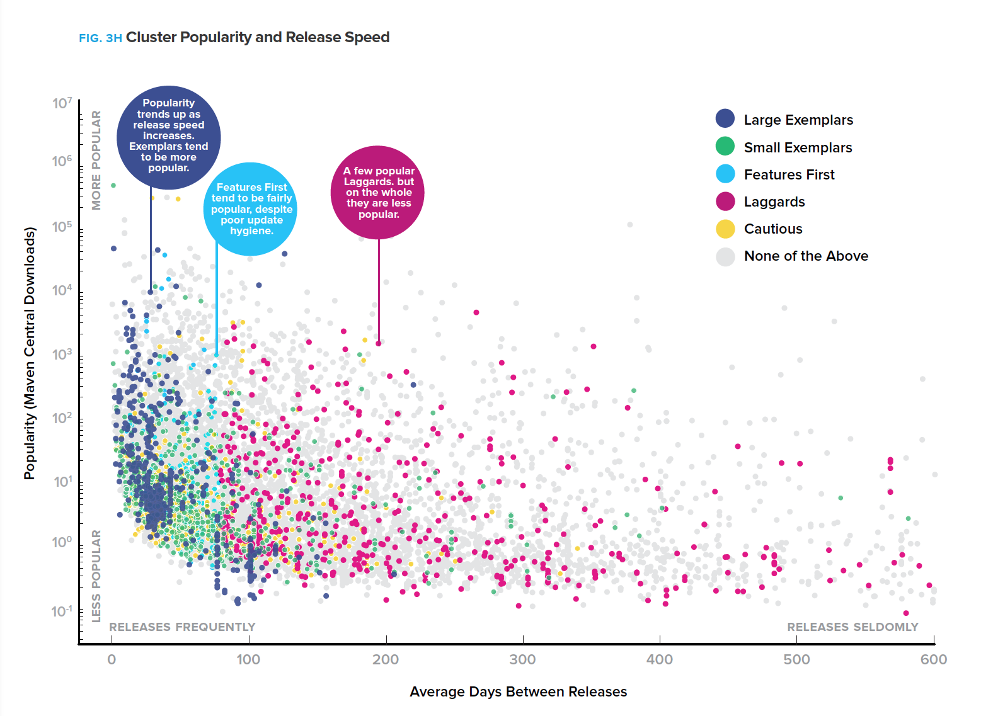
Exemplars release fast and tend to be more popular.
Pick suppliers from here.

Slide 46
Not all popular projects are exemplary and release fast
Don’t pick suppliers from here.
Notes:
so we have the difference of populations in different colors you can see the exemplars over here at the lab so this is the plot of popularity vs. update
I'm So at the left you see products releasing frequently and they tend to be more popular in the exemplars in particular are more generally more popular and release frequently
and then another thing to note is what I said before about hypothesis for not all popular projects or exemplary by so that you can see through the prevalence the big spread of red dots across their right in and some very popular projects that have very poor update I had

Slide 47
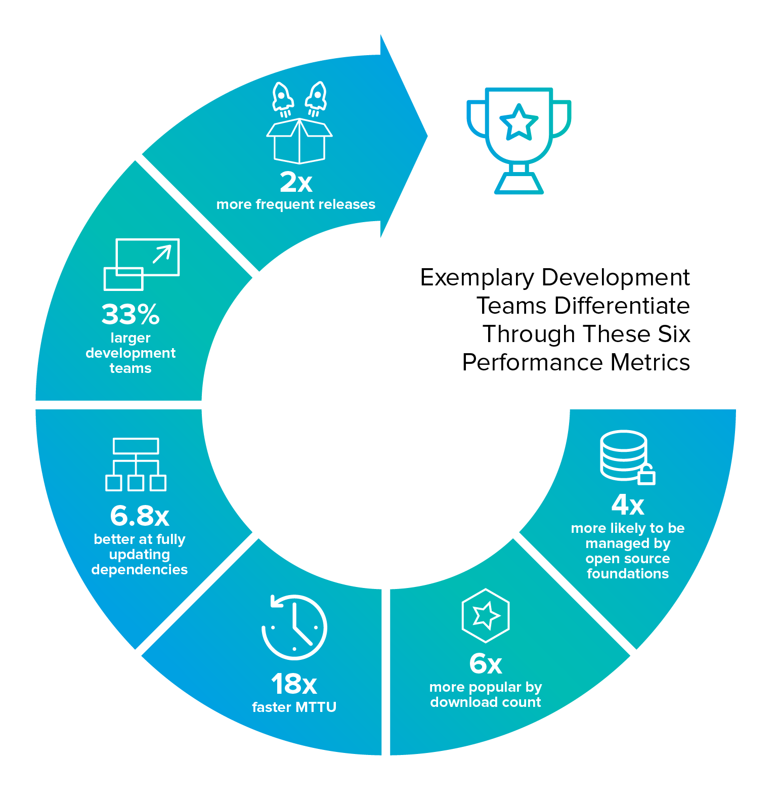
Exemplar Suppliers (OSS Project Teams)

Slide 48


Enterprise Devs Manage Dependencies
50%
YES
46%
YES
38%
YES
37%
YES
30%
YES
n = 658
We schedule updating dependencies as part of our daily work
We strive to use the latest version (or latest-N) of all our dependencies
We use some process to add a new dependency (e.g., evaluate, approve, standardize, etc.)
We have a process to proactively remove problematic or unused dependencies
We have automated tools to track, manage, and/or ensure policy compliance of our dependencies
@weekstweets

Slide 49
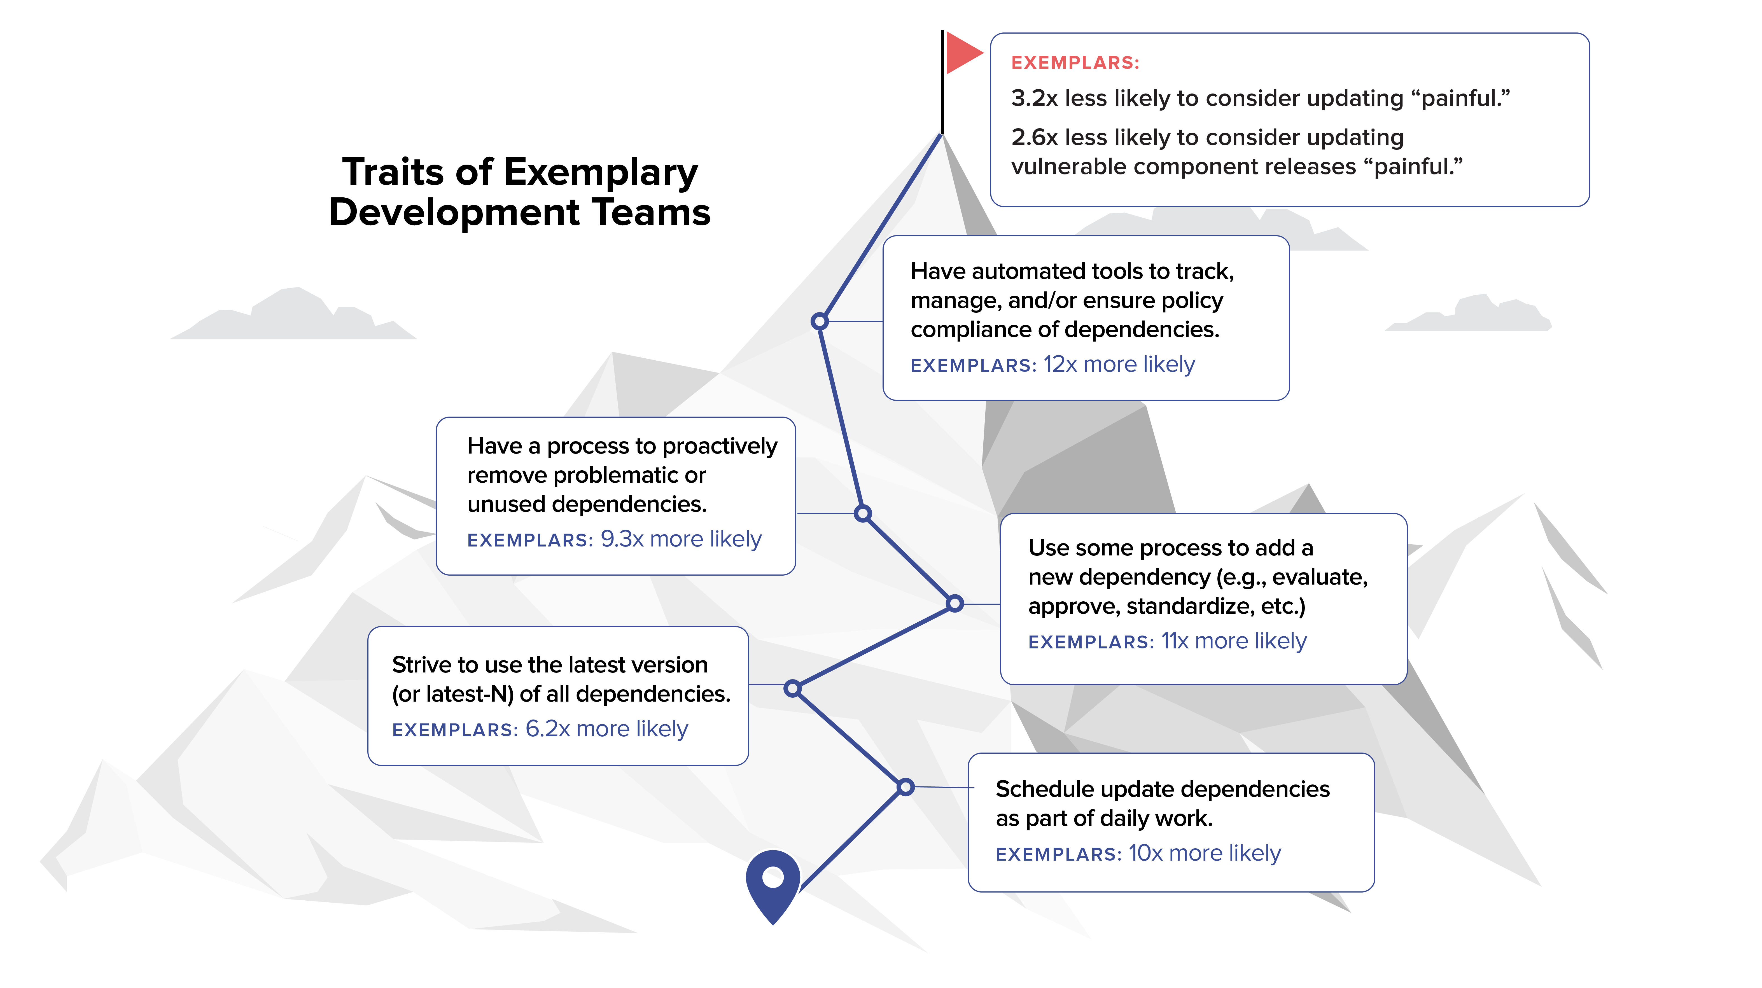
When Devs climb the mountain every day, it’s easier.
@weekstweets

Slide 50
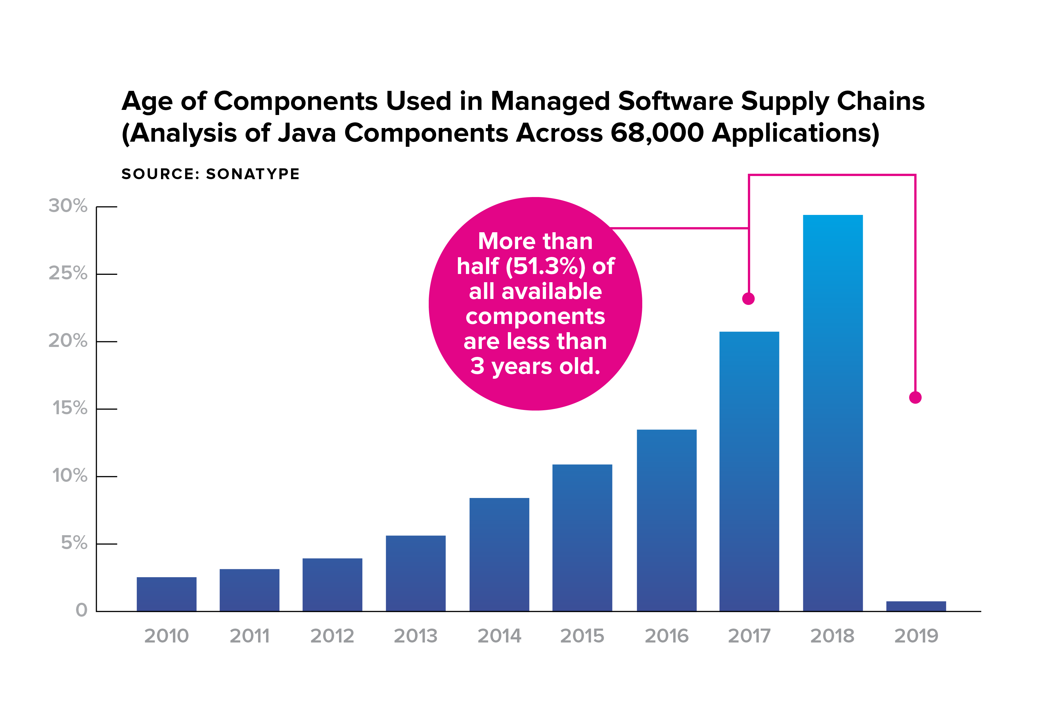
@weekstweets

Slide 51
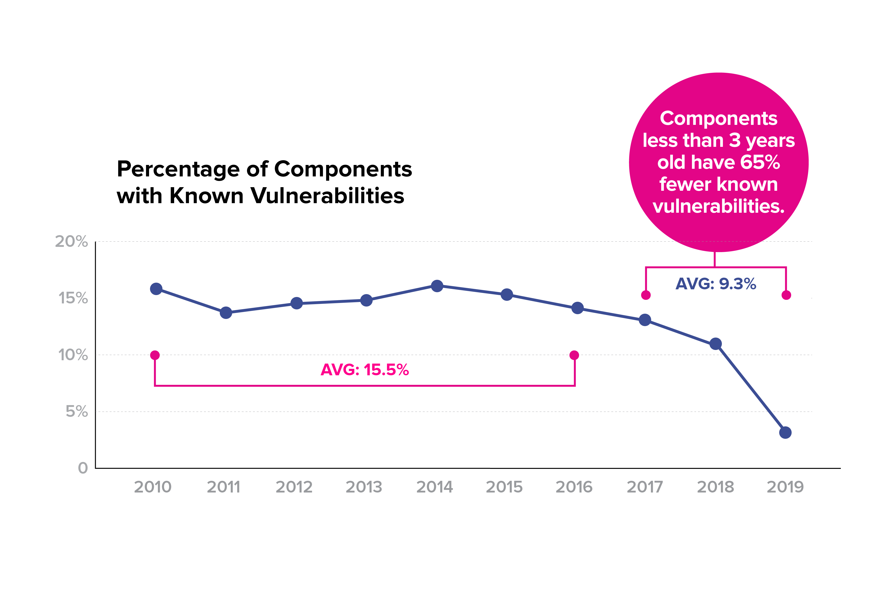
@weekstweets

Slide 52

2010: Jez Humble
Notes:
It was then no mistake in 2010, when Jez Humble and Dave Farley advised people to “Build Quality In” in their seminal book “Continuous Delivery”
as people heard about and strove to achieve Allspaw’s 10 deploys a day.

Slide 53
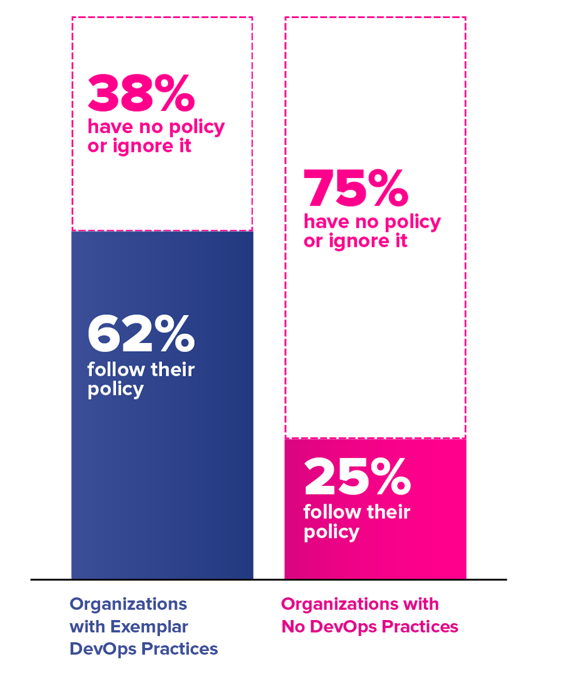
Do you have an open source policy and do you follow it?
Automation continues to prove difficult to ignore.

Slide 54
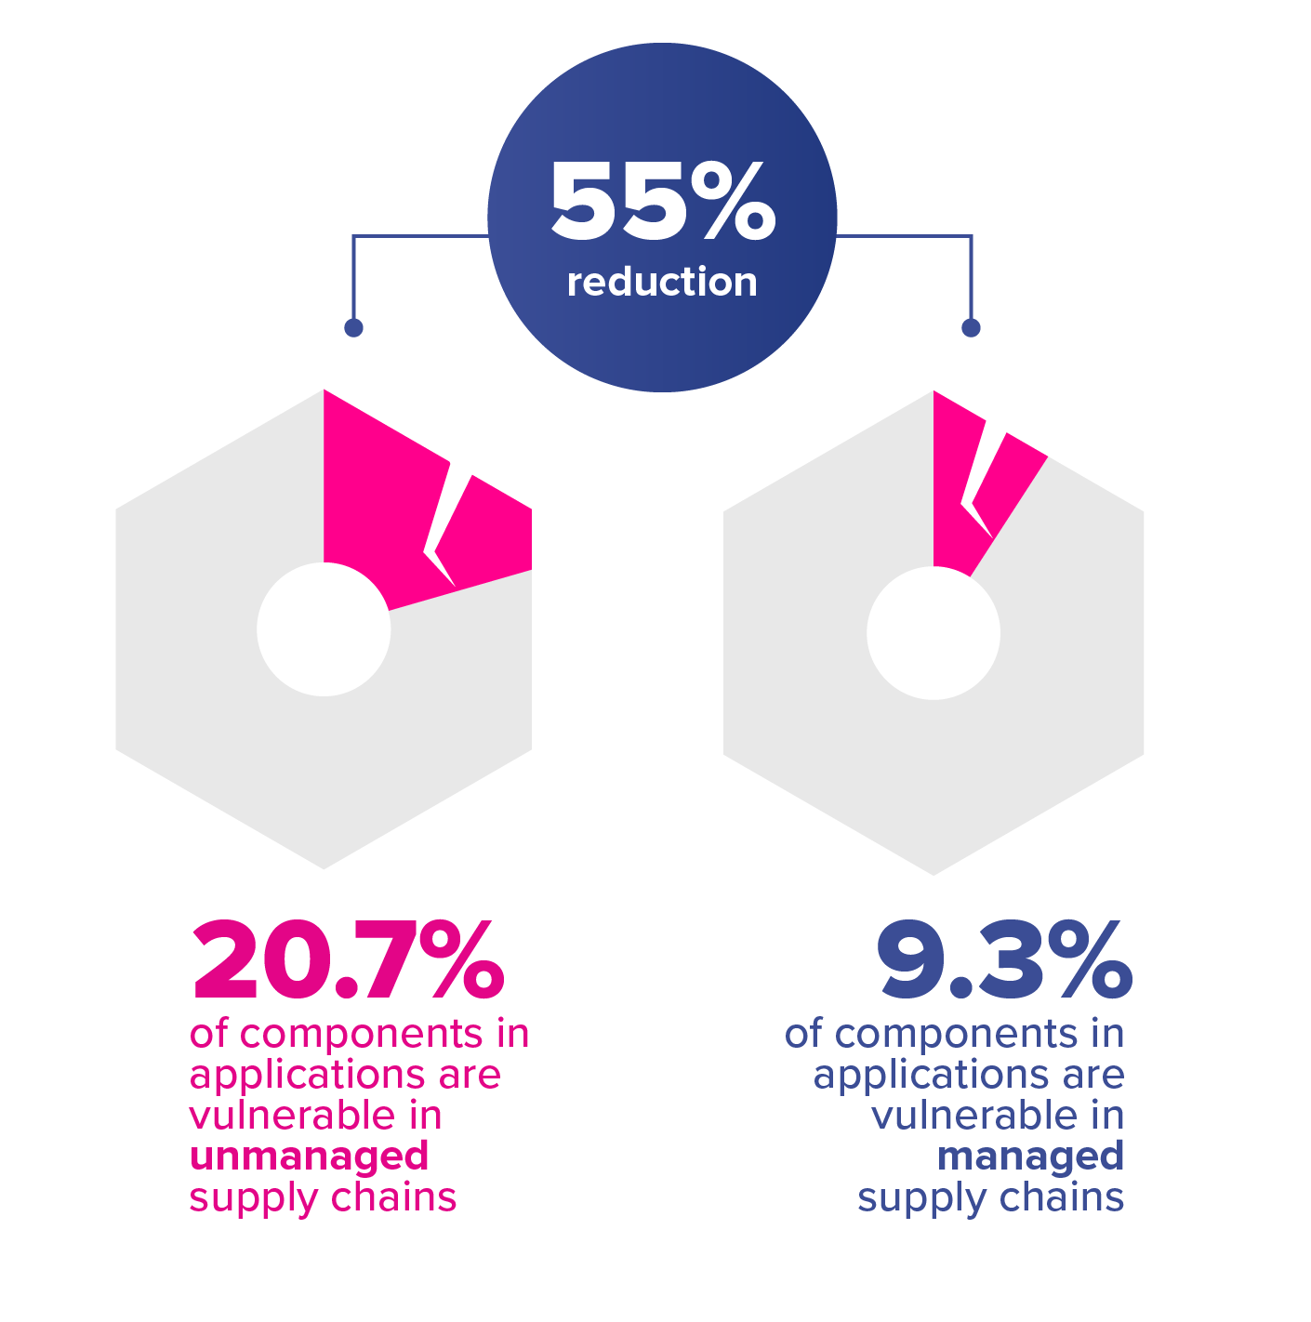
For organizations who tamed their supply chains, the rewards were impressive.
@weekstweets
Notes:
For organizations who tamed their supply chains, the rewards were impressive: use of known vulnerable component releases was reduced by 55%.

Slide 55
imagine quality at insane speed
@weekstweets
Notes:
Imagine quality at insane speed
Imagine secure development
Imagine machines developing their own code

Slide 56
imagine secure development
@weekstweets
Notes:
Imagine quality at insane speed
Imagine secure development
Imagine machines developing their own code

Slide 57
imagine machines
developing their own code
@weekstweets
Notes:
Imagine quality at insane speed
Imagine secure development
Imagine machines developing their own code

Slide 58


